Slide 1
Year 3 and 4
Multiplication Check
Parent Workshop
Thursday 3rd March
Striving for Excellence

Slide 2
Aims
To achieve a stronger understanding of what the Multiplication Tables Check (MTC) is and what the expectations are.
To understand how, when and why the Multiplication Tables Check (MTC) will be administered.
To achieve a stronger understanding of how times tables is taught at Key Stage 2.
To provide you with a range of strategies and websites you can use with your child at home.
Striving for Excellence

Slide 3
Under the current National Curriculum, children are supposed to know their times tables by the end of Year 4. The Multiplication Tables Check has been introduced to ensure that children do know their tables.
National Curriculum
Striving for Excellence

Slide 4
From the 2019/20 academic year onwards, all state-funded maintained schools and academies (including free schools) in England will be required to administer the MTC to Year 4 pupils.
Do all pupils in the UK need
to take the MTC?
Striving for Excellence

Slide 5
- Children with an EHCP will be provided for when taking the MTC e.g., extra time, an adult to read out the question, an enlarged screen, etc. - Some pupils may be withdrawn from the assessments. Further details will be provided by the DfE.
What if my child has a statement of special educational needs?
Striving for Excellence

Slide 6
- All Year 4 children will have their multiplication skills formally tested in the Summer Term of this academic year. - Schools will have a 3 week window to administer the MTC. (Monday 6th June 2022 – Friday 24th June 2022) - Teachers will have the flexibility to administer the check to individual pupils, small groups or a whole class at the same time.
When will the Multiplication Tables
Check be administered?
Striving for Excellence

Slide 7
• School-level results and individual pupil results will be made available to schools. This will allow schools to provide additional support to pupils who require it. • As is the case with the phonics check (KS1), school-level results will be available to selected users including Ofsted. • National results will be reported by the Department for Education (DfE) to track standards over time. • National and local authority results will be reported by the DfE to allow schools to benchmark the performance of their pupils.
How will the MTC data be used?
Striving for Excellence

Slide 8
Children will be tested using an on-screen check (on a computer or a tablet), where they will have to answer multiplication questions against the clock. Calculators and wall displays that could provide children with answers will be removed from the room the MTC is taking place in. The test will last no longer than 5 minutes and is similar to other tests already used by primary school. It will be automatically scored, and results will be available to schools once the assessment window closes at the end of the week assessment period.
How will the Multiplication Tables Check be administered?
Striving for Excellence

Slide 9
Children will have 6 seconds to answer each question in a series of 25 questions. This allows pupils the time required to demonstrate their recall of multiplication tables, whilst limiting pupils’ ability to work out answers to the questions. Each question will be worth one mark and be presented to the child in this format: _ x _ = ____
How will the Multiplication
Tables Check be administered?
Striving for Excellence

Slide 10
The Year 4 programme of study for mathematics (National Curriculum) also states, ‘pupils should be taught to recall multiplication and division facts for multiplication tables up to 12 × 12’. However, the MTC only assesses the instant recall of multiplication facts. Multiplication and division in a wider context will continue to be assessed through the KS1 and KS2 mathematics assessments.
How will the Multiplication
Tables Check be administered?
Striving for Excellence

Slide 11
Questions will be selected from the 121 number facts that make up the multiplication tables from 2 to 12, with a particular focus on the 6, 7, 8, 9 and 12 times tables as they are considered to be the most challenging. Each question will only appear once in any 25-question series, and children won't be asked to answer reversals of a question as part of the check e.g., (so if they've already answered 3 x 4 they won't be asked about 4 x 3).
How will the Multiplication
Tables Check be administered?
Striving for Excellence

Slide 12
Once the child has inputted their answer on the computer / device they are using, there will be a three-second pause before the next question appears. Children will be given the opportunity to practise answering questions in this format before the official check begins.
How will the Multiplication
Tables Check be administered?
Striving for Excellence

Slide 13
At present the DfE have not issued an official "pass mark“. Watch the video for additional information https://youtu.be/GhAJMJUsAac
What is the pass mark for the test?
Striving for Excellence

Slide 14
How are we preparing pupils for the MTC?
How is multiplication taught in Year 3 and 4?
Through songs / chants
Times Table Rockstars
Using knowledge of key tables facts
Multiplication games
Identifying patterns
Daily recall tasks.
Big Maths, Beat That
Speed Grid Challenges
Striving for Excellence

Slide 15
BASELINE TEST https://www.timestables.co.uk/multiplication-tables-check/ or Soundcheck on TT Roskstars
Striving for Excellence

Slide 16
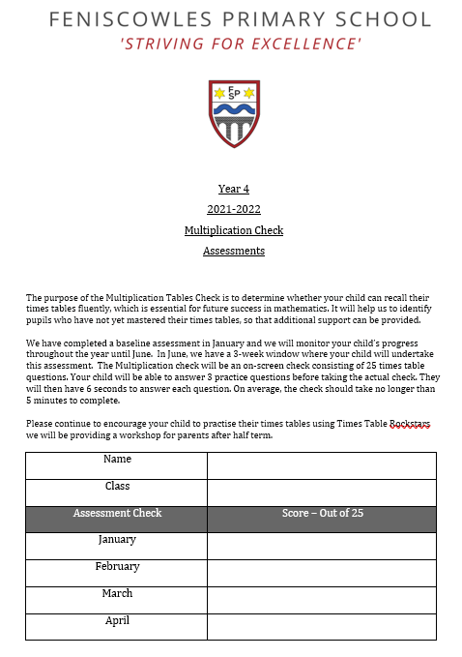
Striving for Excellence

Slide 17
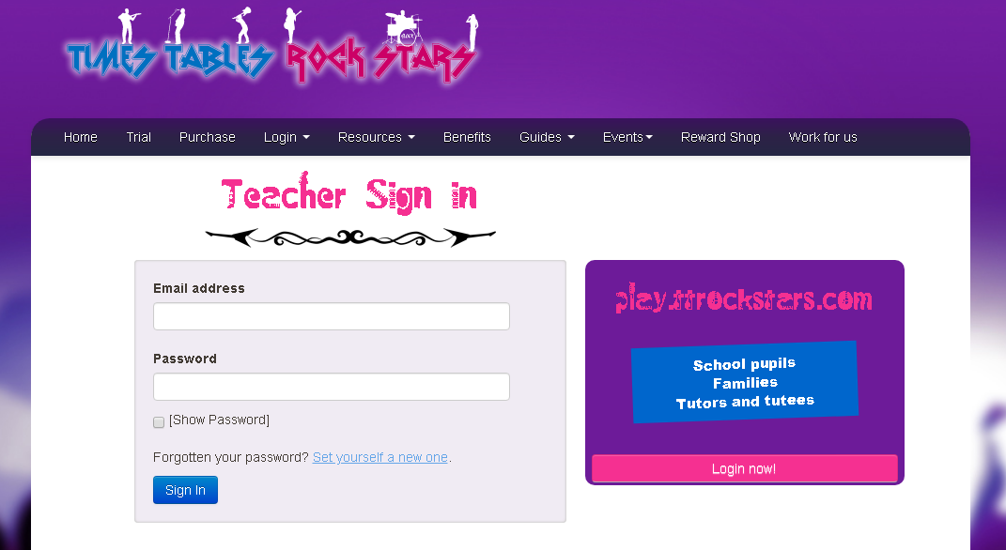
Times Tables Rock Stars https://ttrockstars.com/login https://www.timestables.co.uk/multiplication-tables-check/
What can you do at home to support your child?
Striving for Excellence

Slide 18
TIMES TABLES ROCKSTARS https://ttrockstars.com/login -At home and in-school learning platform -Get your child to practise daily for 15 minutes
Striving for Excellence

Slide 19
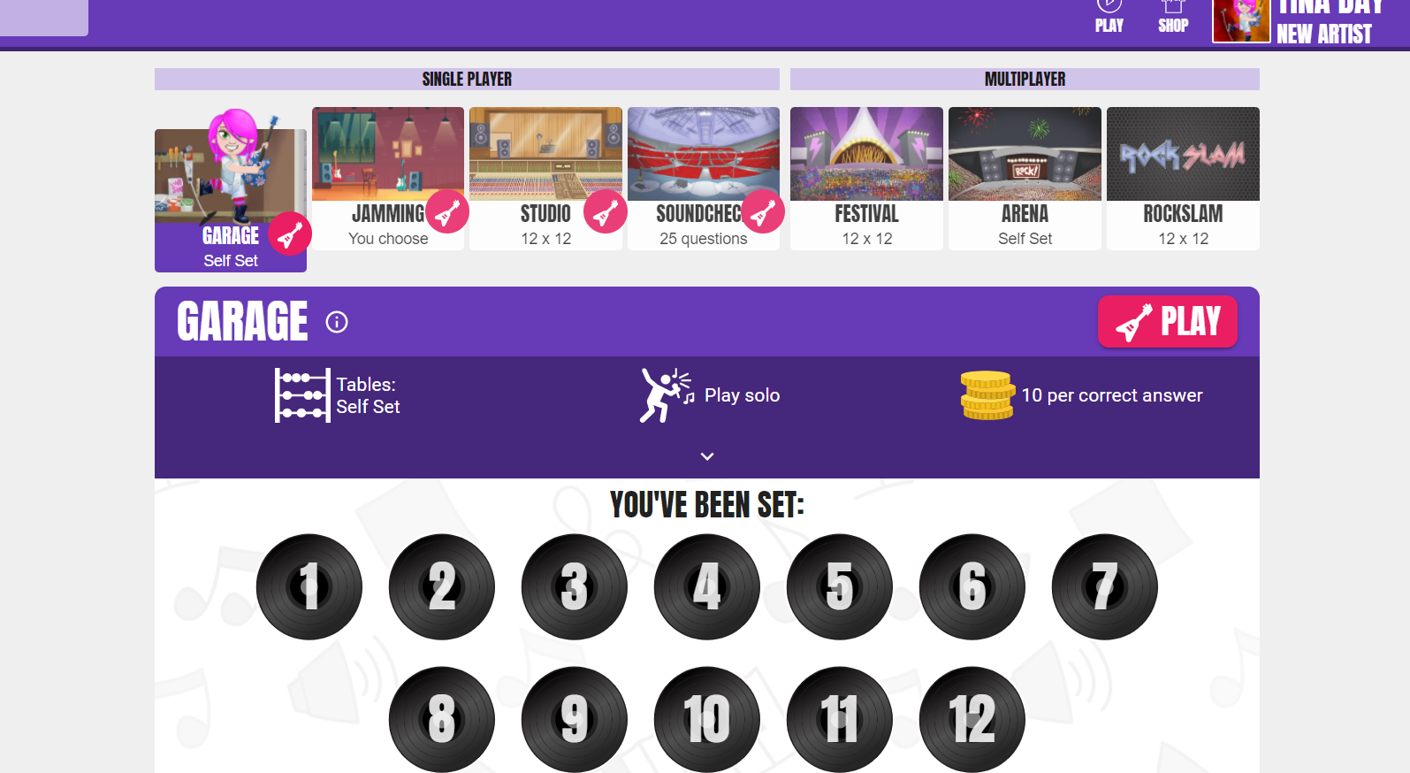
Striving for Excellence

Slide 20
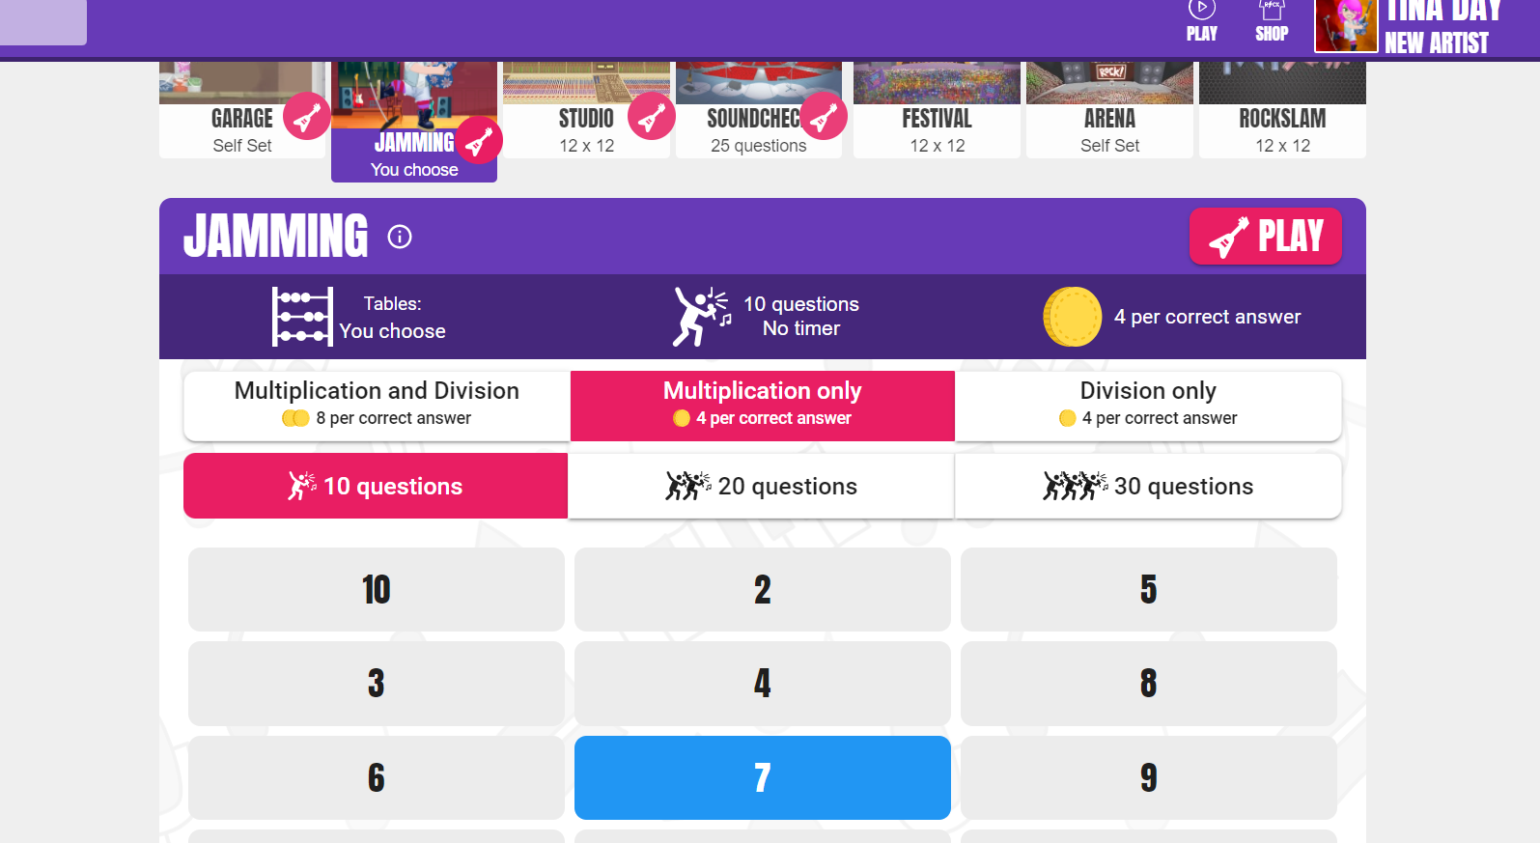
Striving for Excellence

Slide 21
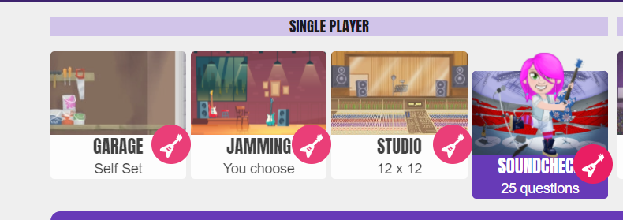
Striving for Excellence

Slide 22
National Curriculum https://assets.publishing.service.gov.uk/government/uploads/system/uploads/attachment_data/file/335158/primary_national_curriculum_-_mathematics_220714.pdf Department of Education (DfE ) https://www.gov.uk/guidance/multiplication-tables-check-development-process
Useful Websites
Striving for Excellence

Slide 23
Useful Websites
Maths Games http://www.maths-games.org/times-tables-games.html
Cool Maths https://www.coolmathgames.com/
Ixl https://uk.ixl.com/
Times tables Rock starS https://ttrockstars.com/
Topmarks https://www.topmarks.co.uk/
DfE Video - https://youtu.be/GhAJMJUsAac
Striving for Excellence

Slide 24
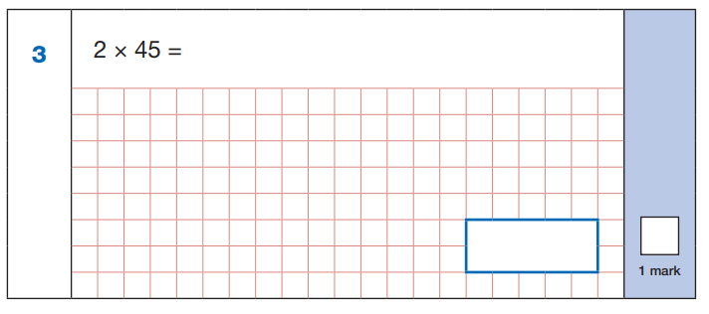
Year 3:
2 x 40 = 80
2 x 5 = 10
80 + 10 = 90
90
Children need to:
Know x2 is the same as double
Do 2 x 4 to help with 2 x 40; 2 x 5
Striving for Excellence

Slide 25
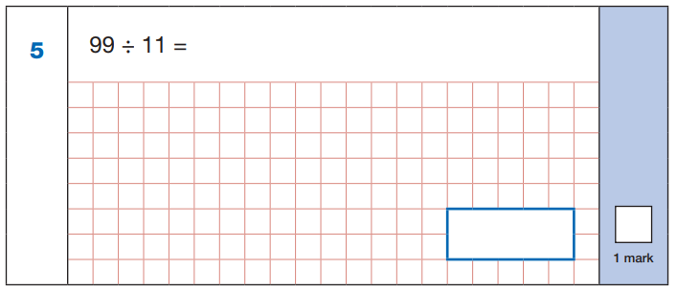
Year 4:
9 x 11 = 99
99 ÷ 11 = 9
9
Children need to:
Know x11 tables
Know that 9 x 11 = 99 so 99 ÷ 11 = 9 (inverse)
Striving for Excellence

Slide 26
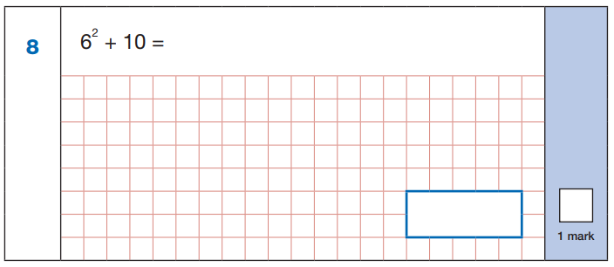
Year 4:
6 x 6 = 36
36 + 10 = 46
46
Children need to:
Know 6 squared is the same as 6 x 6 (= 36)
Striving for Excellence

Slide 27
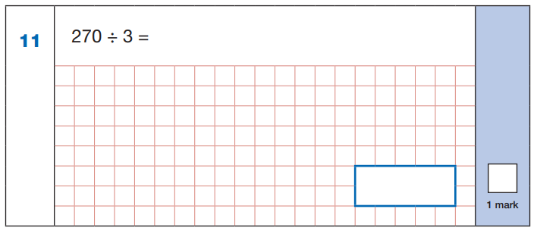
Year 4:
3 x 9 = 27
So 3 x 90 = 270
270 ÷ 3 = 90
90
Children need to:
Know 3 x 9 = 27 so 3 x 90 = 270
Know that 3 x 90 = 270 so 270 ÷ 3 = 90 (inverse
Striving for Excellence

Slide 28
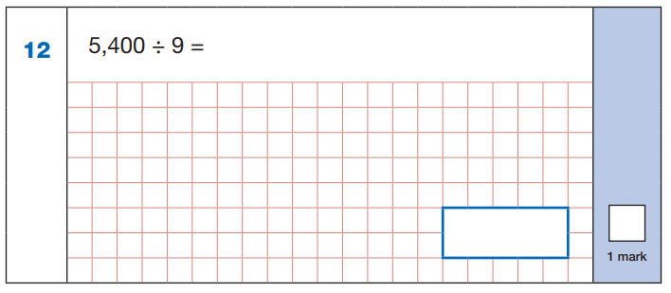
Year 4:
9 x 6 = 54
9 x 600 = 5,400
5,400 ÷ 9 = 600
600
Children need to:
Know 9 x 6 = 54 so 9 x 600 = 5,400
Know that 9 x 600 = 5,400 so 5,400 ÷ 9 = 600 (inverse)
Striving for Excellence

Slide 29
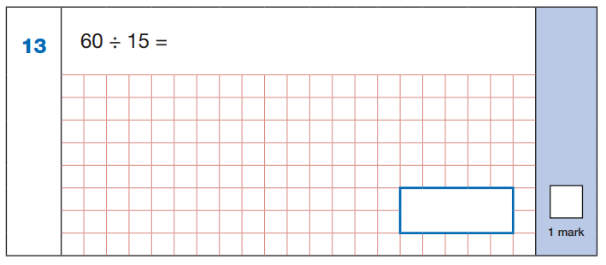
Year 5:
15 x 4 = 60
60 ÷ 15 = 4
4
Children need to:
Recognise that 15 is ¼ of 60
Know that 15 x 4 = 60 so 60 ÷ 15 = 4
Striving for Excellence

Slide 30
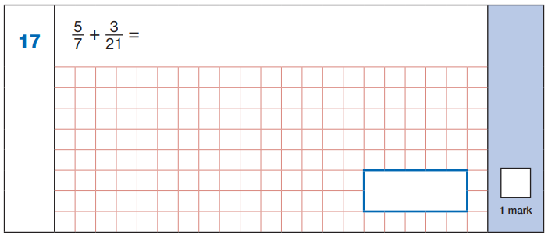
Year 5:
x3
5 =
7
15
21
x3
15 + 3 = 18
21 21 21
18
21
Children need to:
Know 21 = 7 x 3
Multiply the numerator by 3 (5 x 3 = 15) and the denominator by 3 (7 x 3 = 21) to create the equivalent fraction 15/21 to use in the calculation
Striving for Excellence

Slide 31
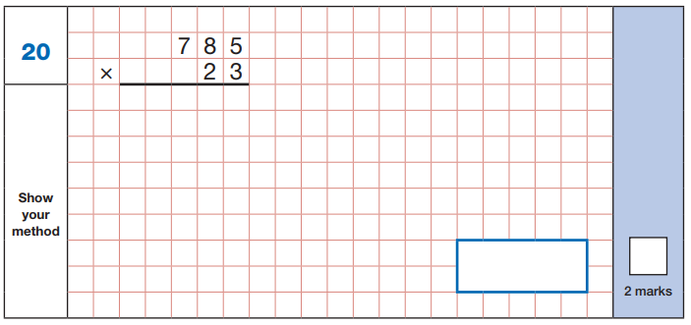
Year 6:
3 x 5
3 x 8
3 x 7
2 x 5
2 x 8
2 x 7
2
1
2 3
5
5
1
1
1 5
7
0
0
1
8
0
5
5
1
18055
Children need to:
Know 3 x 5; 3 x 8; 3 x 7; 2 x 5; 2 x 8; 2 x 7
(as well as how to carry out this procedure accurately)
Striving for Excellence

Slide 32
Year 6:
1,200 ÷ 100 = 12
12 x 20 = 240
240
Children need to:
Divide by 100 (1,200 ÷ 100 = 12)
Do 12 x 20 (12 x 2 or 12 x 10 helps here)
Striving for Excellence

Slide 33
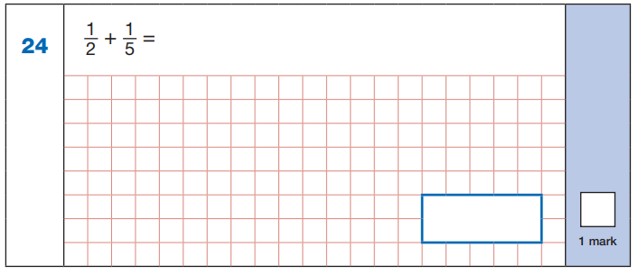
Year 6:
x5
x2
1 = 5
2 10
1 = 2
5 10
x5
x2
5 + 2 = 7
10 10 10
7
10
Children need to:
Know that 2 and 5 are both factors of 10
Multiply the numerators and denominators of the first fraction by 5 (1 x 5; 2 x 5)
Multiply the numerators and denominators of the second fraction by 2 (1 x 2; 5 x 2)
Striving for Excellence

Slide 34
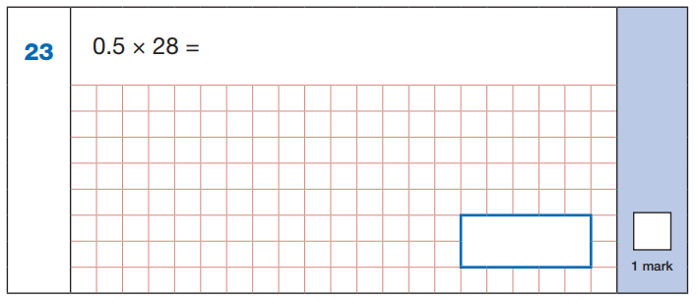
Year 6:
Half of 28 is 14
14
Children need to:
Know that 0.5 = ½
Know that multiplying a number by ½ halves it
Know not to try 5 x 28 or 5 x 20 and 5 x 8 and then divide that by 10)
Striving for Excellence

Slide 35
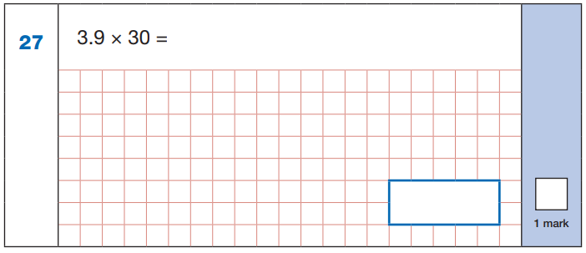
Year 6:
4 x 30 = 120
30 x 0.1 = 3.0 (3)
120 – 3 = 117
117
Children need to:
Know that 4 x 30 = 120 (4 x 3 = 12 helps with this)
Know that 30 x 0.1 = 3.0 (30 x 1 = 30 helps with this)
Striving for Excellence

Slide 36
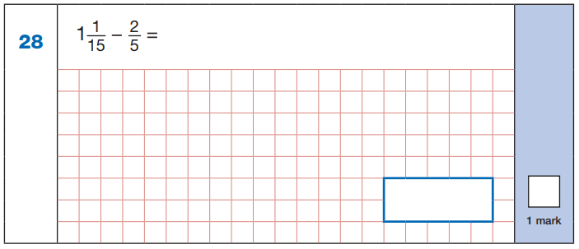
Year 6:
x3
2 =
5
1 1 = 16
15 15
6
15
x3
÷5
16 – 6 = 10 = 2
15 15 15 3
2
3
÷5
Children need to:
Know that 5 x 3 = 15 to make the second fraction into 6/15 (also 2 x 3 = 6)
Do 1 x 15 + 1 = 16 to make improper fraction 16/15
Know that both 10 and 15 are multiples of 5 so ÷ 5
Striving for Excellence

Slide 37
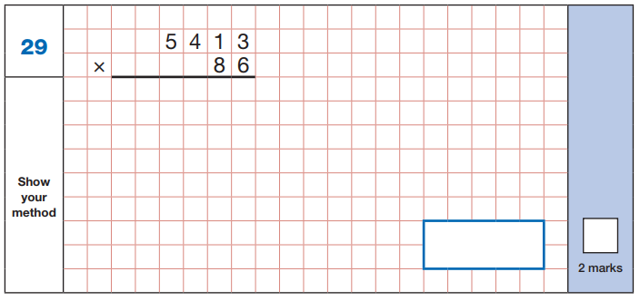
Year 6:
6 x 3
6 x 1
6 x 4
6 x 5
8 x 3
8 x 1
8 x 4
8 x 5
2
4
1
3 2
7
8
1
2
3
0
4
0
4 3
3
4 6
5
5
1
8
1
654418
Children need to:
Know 6 x 3; 6 x 1; 6 x 4; 6 x 5; 8 x 3; 8 x 1; 8 x 4; 8 x 5
(as well as how to carry out this procedure accurately)
Striving for Excellence

Slide 38
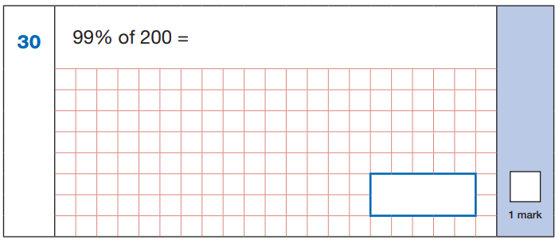
Year 6:
99% of 100 = 99
200 is double 100
double 99 is 198
198
Children need to:
Divide by 100 (200 ÷ 100 = 2)
Or to do it very quickly know that 200 is 100 x 2
Striving for Excellence

Slide 39
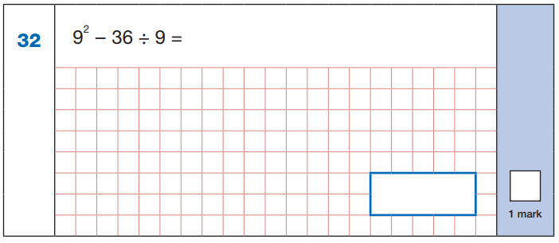
Year 5/6:
36 ÷ 9 = 4
9 x 9 = 81
81 – 4 = 77
77
Children need to:
Know that 9 squared is 9 x 9 = 81
Know that 9 x 4 = 36
Striving for Excellence

Slide 40
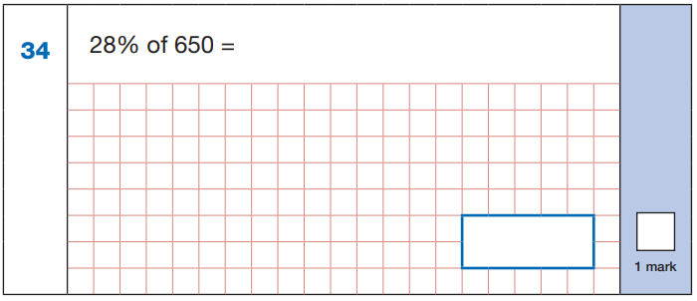
Year 6:
2 8
x 6.5
14.0
+ 168.0
182.0
650 ÷ 100 = 6.5
28 x 6.5 =
28 x 6 =
20 x 6 = 120
8 x 6 = 48
120 + 48 = 168
28 x 0.5 =
half of 28 = 14
168 + 14 = 182
168
182
Children need to:
Divide by 100 (650 ÷ 100 = 6.5)
For 28 x 6.5 use knowledge of 6 x 2, 6 x 8
Know that 0.5 x a number means to half it
Striving for Excellence

Slide 41
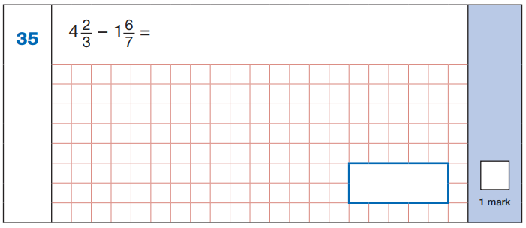
Year 6:
x7
4 x 21 = 84
84 + 14 = 98
98
21
2 = 14
3 21
98 – 39 = 59
21 21 21
x7
x3
6 = 18
7 21
1 x 21 = 21
21 + 18 = 39
39
21
59
21
x3
Children need to:
Know that 3 and 7 are both factors of 21 ( 3 x 7 = 21)
Do 2 x 7 and 3 x 7 to convert first fraction to 14/21
Do 6 x 3 and 7 x 3 to convert second fraction to 18/21
Do 4 x 21 (4 x 2 and 4 x 1 helps) to convert mixed number to improper fraction: 98/21
Do 1 x 21 to convert mixed number to improper fraction: 39/21
Striving for Excellence

Slide 42
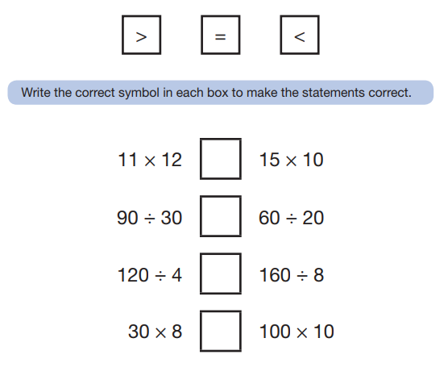
Year 6:
132 =
<
= 150
3 =
=
= 3
30 =
>
= 20
240 =
<
= 1,000
Children need to:
Know 11 x 12; 15 x 10; 3 x 3; 2 x 3; 4 x 3; 2 x 8; 3 x 8; 10(0) x 10
Use knowledge of multiples of 10 and inverse
Striving for Excellence

